Slide 1


Cloudburst Risk Prediction and Mapping System
Graphic era hill university
Archit rawat | 2218456 | G1 | 15
Akash Bhardwaj | 2218261 | A1 | 06
Aditya Negi | 2218215 | J2 | 24
Submitted to:- Dr. Amit Gupta

Slide 2

The Challenge of Cloudbursts
Cloudbursts are among the most catastrophic and unpredictable natural disasters, characterized by an extreme amount of precipitation in a very short period over a small geographical area. The frequency and intensity of these events have been increasing, especially in geologically fragile and densely populated areas like the Himalayan regions. The socioeconomic consequences are immense, leading to massive flash floods, debris flows, landslides, and widespread destruction of property and life. Our current disaster preparedness often relies on a fragmented approach, which has left a critical gap in a reliable, early warning system capable of providing precise, actionable, and hyper-local forecasts.
Our Core Objectives
Our vision is to develop a next-generation cloudburst prediction and early warning system. This project aims to create an intelligent, data-driven platform that transcends a simple weather forecast by integrating meteorological, machine learning, and geomorphological data to provide a comprehensive, risk-based assessment. The ultimate goal is to provide proactive and actionable intelligence for disaster management, enabling authorities and communities to prepare for and mitigate the consequences of these extreme events, thereby shifting from a reactive to a proactive disaster management strategy.

Slide 3

Is This Project Feasible?
Yes, this project is entirely feasible. From a technological perspective, we have access to modern machine learning models like LSTMs and CNNs, which are specifically designed to handle the time-series and visual data required for this problem. Scalable cloud computing services, such as AWS or Google Cloud, make the intensive, real-time analysis required for such a system possible. From a data perspective, a wide range of high-resolution datasets are publicly available, including satellite data from NASA's GPM and reanalysis data from IMDAA and ERA5, as well as real-time APIs. And operationally, the system is designed to be deployed on a cloud-native infrastructure, making it scalable, resilient, and viable for integration with existing government platforms like NDMA.
Re-thinking Cloudbursts
We are moving beyond the conventional definition of a cloudburst, which has been anchored to a strict quantitative benchmark like 100mm per hour. Historical case studies have shown us that a single metric is often insufficient and can be misleading. Our focus is on an impact-based approach that considers how heavy rain translates into a full-scale disaster. This requires a framework that considers not only instantaneous intensity but also total cumulative volume and, crucially, the unique geographical and vulnerability factors that determine how rain affects a region. The Uttarkashi event in 2012, for instance, highlights how the cause of a high-energy flood can be geologically-driven (from a Glacial Lake Outburst Flood or GLOF) as well as meteorological, which validates our need for a multi-source data strategy.

Slide 4
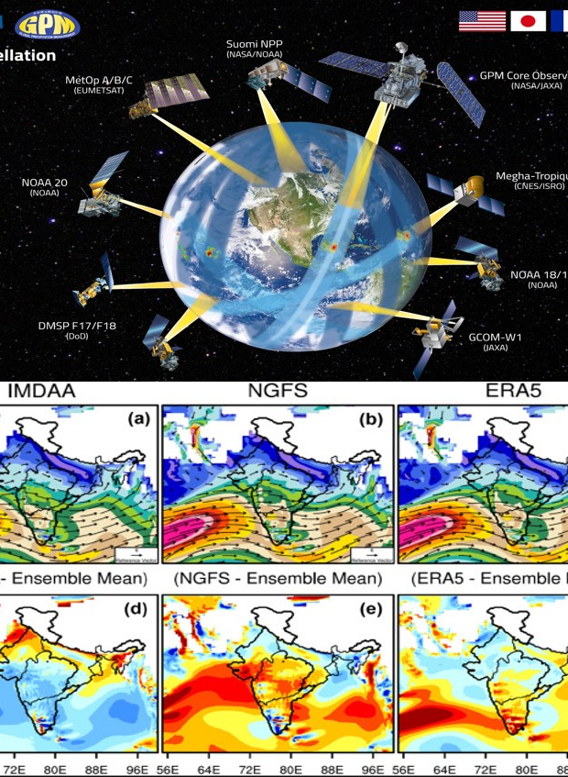
Our Integrated Approach
Our project is based on a multi-layered and modular design that separates the key functions of data processing, modeling, and user communication to ensure robustness, flexibility, and scalability. This is not a single model but a comprehensive framework. The core of our methodology is a multi-source data acquisition strategy that collects information from a diverse range of sources to overcome the inherent challenges of data scarcity and heterogeneity. This data then fuels a hybrid predictive model that fuses the strengths of different algorithms. The ultimate output is disseminated through resilient deployment pipelines and end-user channels, transforming prediction into prevention.
A Multi-Source Data Pipeline
The foundation of our system is a robust and continuous data pipeline that ingests and harmonizes information from a diverse range of sources.
Satellite Precipitation Data: We will use datasets from NASA's Global Precipitation Measurement (GPM) and the Integrated Multi-satellitE Retrievals for GPM (IMERG) to provide high-resolution rainfall estimates in areas with sparse ground stations.
Reanalysis & Historical Data: High-resolution regional datasets like IMDAA and global data like ERA5 are essential for training and validating our models, providing historical context and broader meteorological data.
Real-Time APIs: We integrate APIs like OpenWeatherMap to provide a continuous stream of real-time meteorological variables, including rainfall, humidity, and wind speed, which are essential for dynamic risk computation.
On-the-Ground Sensors: We will deploy simple, low-cost, Arduino-based sensors equipped with rain gauges to provide crucial, hyper-local ground truth data in remote, data-poor areas, augmenting our digital data.

Slide 5
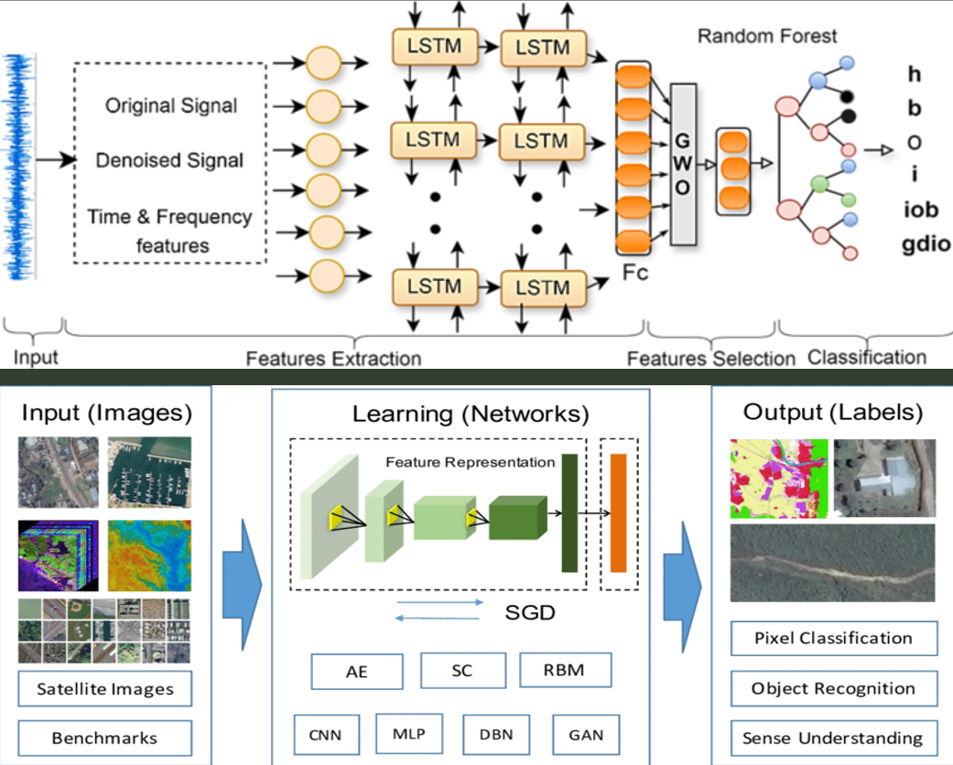
The Hybrid Predictive Engine
The core of our system is a cloud-based inference engine that houses a hybrid machine learning model designed to fuse the strengths of different algorithms and data types. This design directly addresses the multifaceted nature of cloudbursts, enabling the system to detect the full range of precursors—from evolving temporal patterns in meteorological variables to the formation of dense, spatially-confined cloud systems.
Numerical Data Model: A hybrid model, such as a Random Forest and Long Short-Term Memory (RF-LSTM) combination, will process the time-series meteorological data from APIs and reanalysis datasets. The LSTM component is particularly effective at capturing the temporal dynamics and sequential dependencies of the data.
Visual Data Model: A parallel Convolutional Neural Network (CNN) will be trained to analyze unstructured satellite and radar imagery. This model will be able to identify specific cloud shapes and severe weather patterns that precede a cloudburst, providing a spatial component to the prediction.

Slide 6
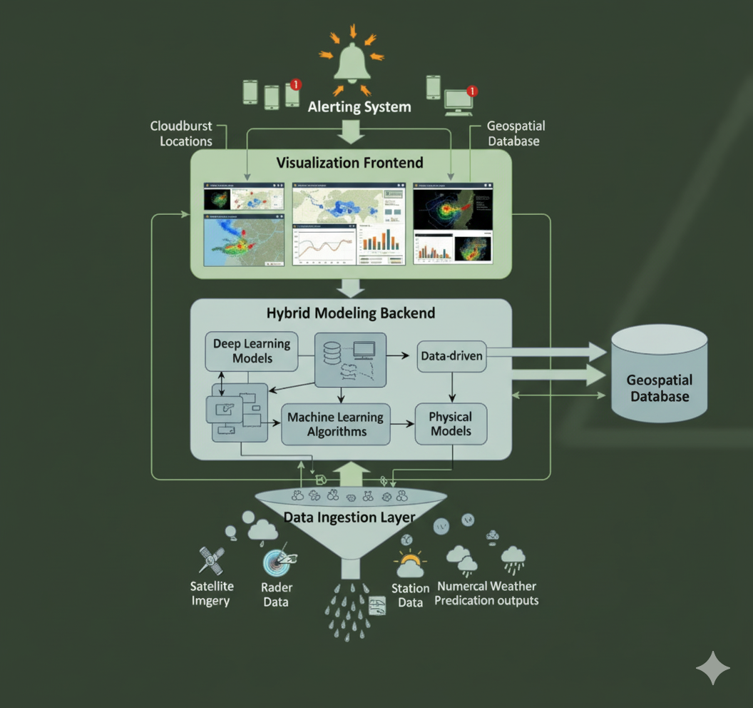
A Robust and Scalable Architecture
Our ideal cloudburst prediction system is built on a layered, modular architecture.
Data Ingestion Layer: This foundational layer is responsible for collecting, cleaning, and preprocessing all incoming data.
Hybrid Modeling Backend: This is a scalable, cloud-based inference engine that houses our core predictive models. A lightweight framework like Flask, running on a scalable cloud service, will serve as the backend, exposing a REST API that generates risk predictions.
Geospatial Database: A relational database with geospatial capabilities, such as PostgreSQL with the PostGIS extension, is essential for efficient storage and retrieval of both time-series and geographical data.
Visualization Frontend: The user-facing component will be dynamic and responsive, using frameworks like React or Gradio to display predictions via interactive maps with color-coded risk heatmaps, time-series charts, and clear alert indicators.
Alerting System: A multi-channel system will disseminate critical alerts to authorities and the public via SMS, app notifications, and voice-based channels, ensuring the message reaches a wide audience.

Slide 7
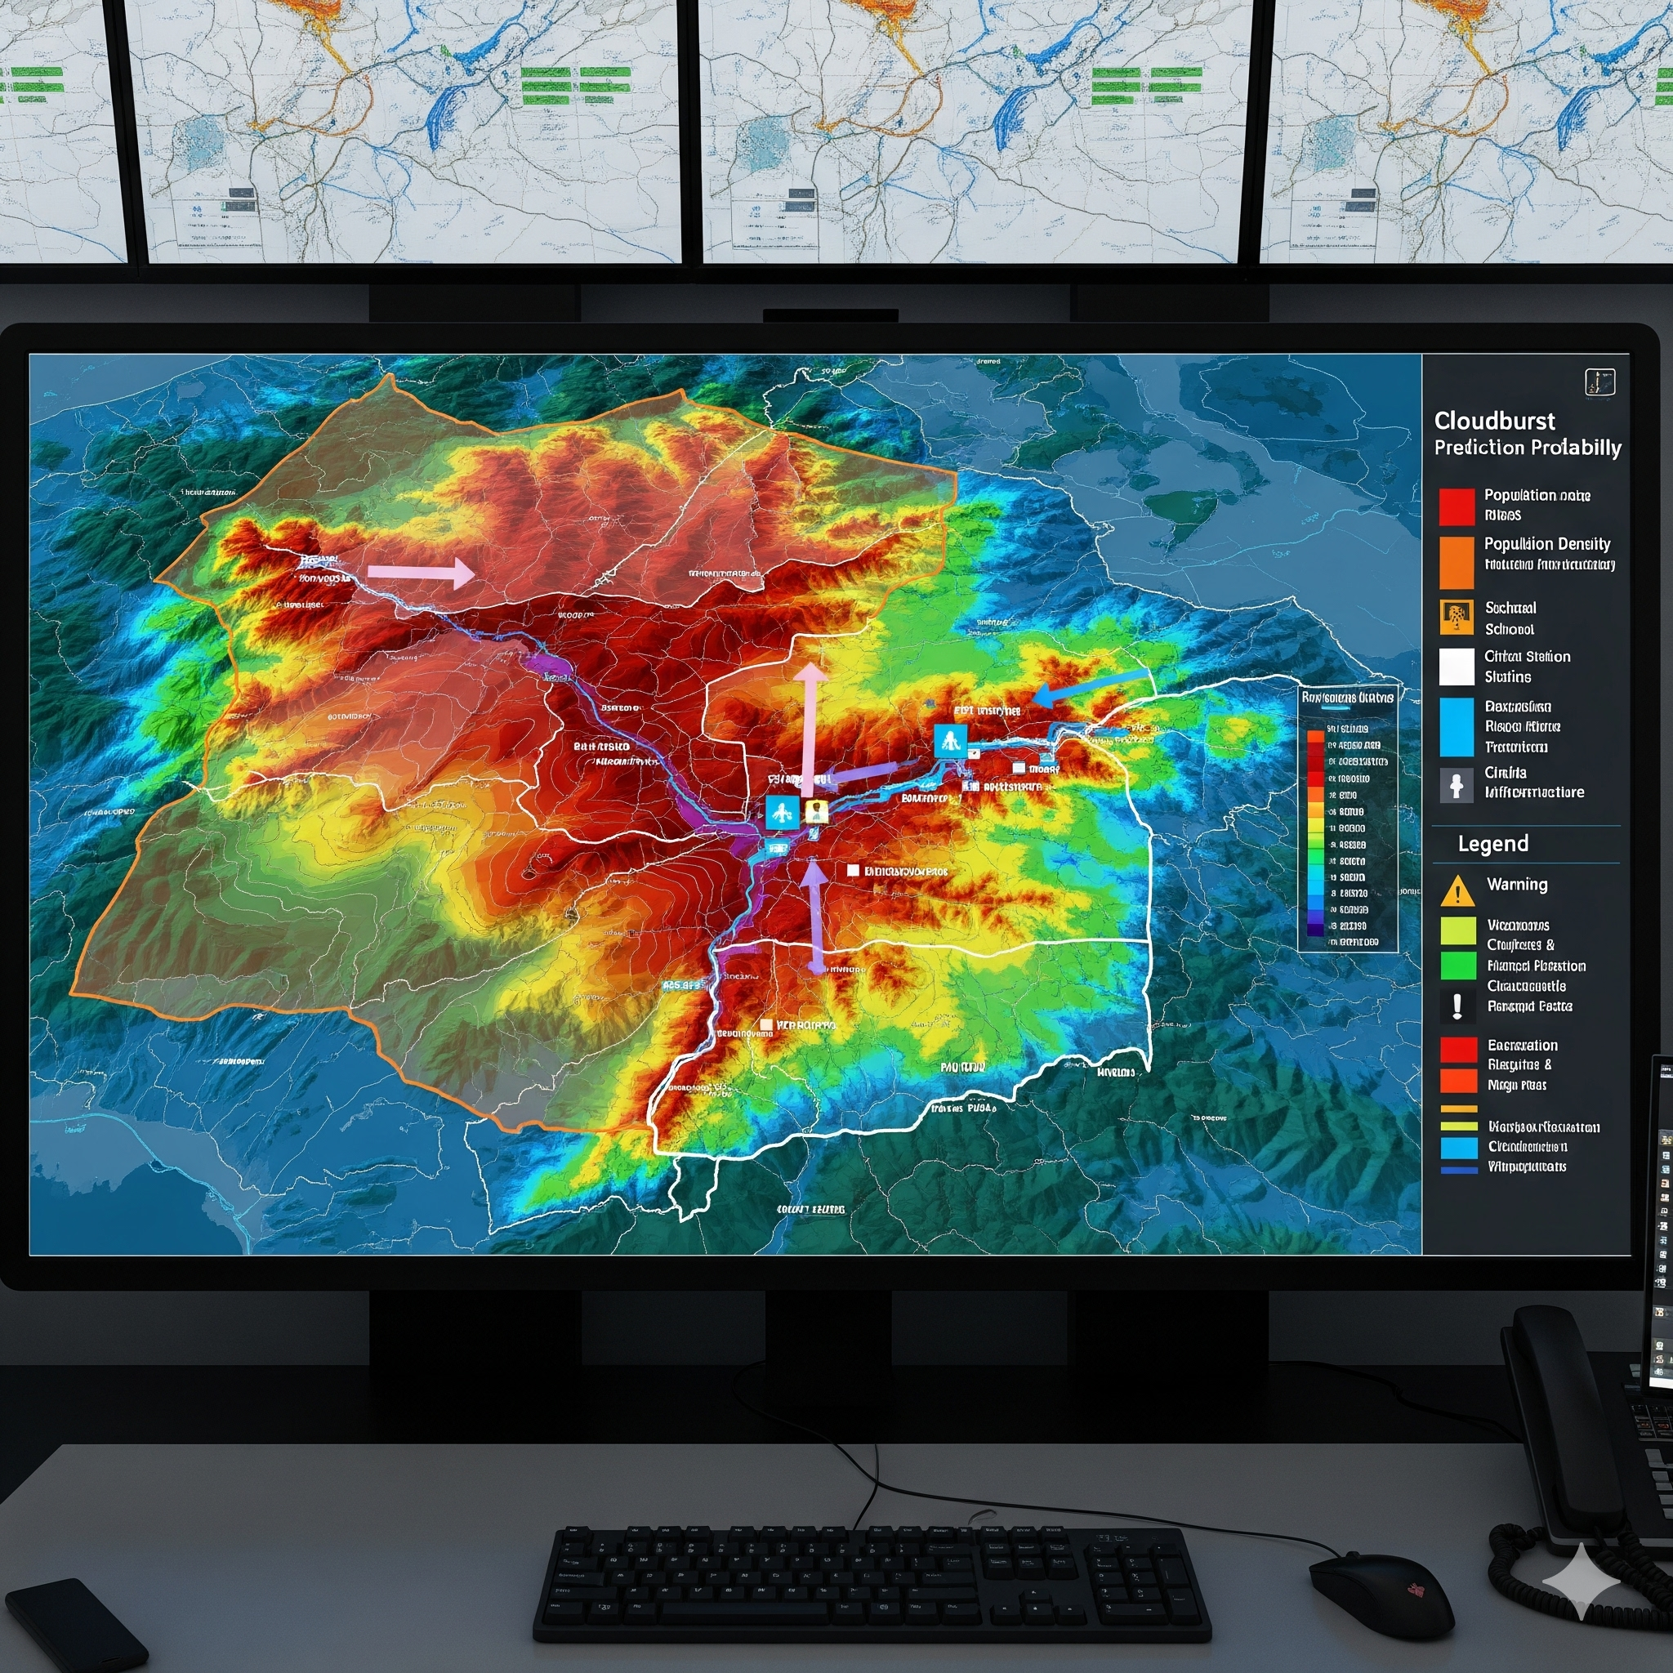
How We Measure Success
We will rigorously evaluate the effectiveness of our prediction models using standard meteorological verification metrics. These include the Probability of Detection (POD), which measures how many true events are correctly predicted, and the False Alarm Ratio (FAR), which quantifies the fraction of false alarms relative to total predictions.
We will also implement event-based scoring, where a prediction is considered correct if it occurs within a precise spatiotemporal window—for example, within ±1 grid cell and ±1 hour of an actual event.
The system is designed with a continuous learning loop, where we will regularly retrain models with new data from real-time feeds, cross-validating with post-event analyses, to progressively improve accuracy over time.
Our Vision for Impact
Our system is expected to deliver a transformational shift in disaster management for cloudburst-prone regions by bridging the gap between scientific forecasts and practical community action. We will generate a dynamic, forecasted risk map with a time slider that allows authorities to visualize future risk levels, enabling proactive planning and resource allocation.
The most critical outcome is the creation of a comprehensive "disaster risk map," which overlays our meteorological predictions with high-resolution geomorphological data, population density maps, and information on critical infrastructure. This will transform our system from a simple predictor into a decision-support tool for disaster prevention.

Slide 8
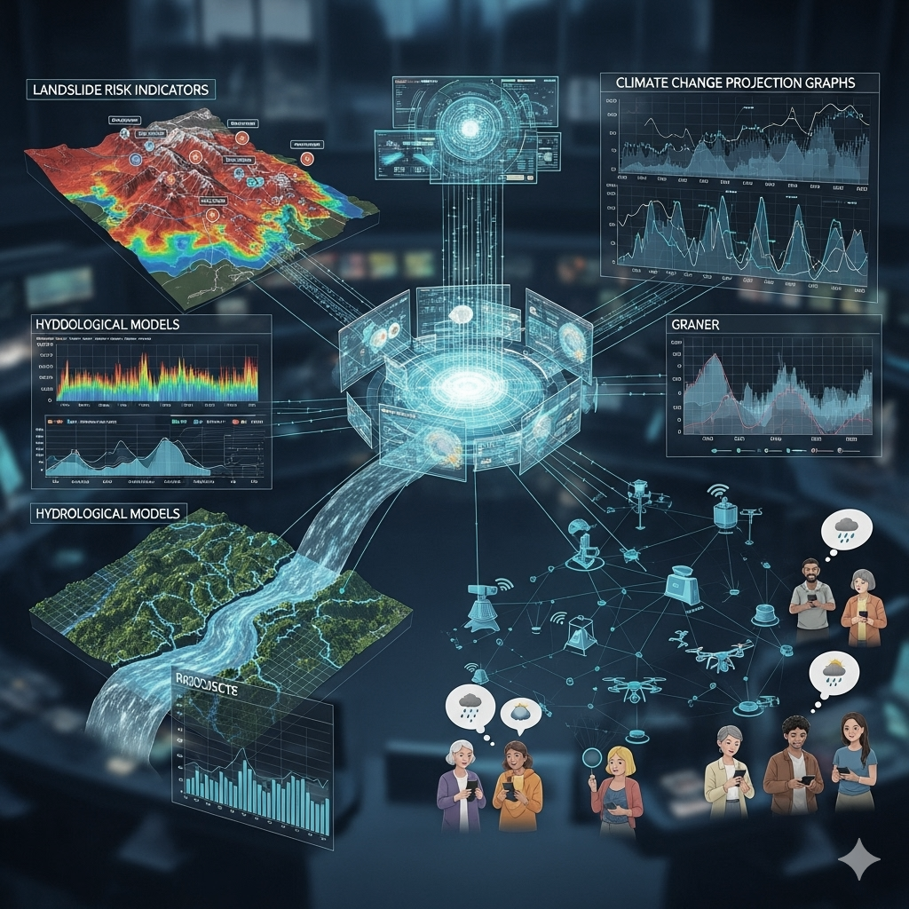
Future Scope & Roadmap
Our project is a living platform that can continuously learn and improve. Our strategic roadmap for future work includes several key initiatives, ensuring our framework is not just a research prototype but an operationally viable system.
Hydrological Coupling: We will integrate our precipitation forecasts with flash flood and river runoff models to predict not just rainfall but also its downstream hydrological impacts. This is a crucial step for providing a complete picture of the disaster.
Multi-Hazard Platform: By combining slope stability models, soil saturation levels, and vegetation indices with our rainfall predictions, the system can be expanded to include landslide risk. This will evolve our project into a multi-hazard early warning platform, addressing the complex, cascading nature of these events in mountainous regions.
Climate Change Projections: We can use downscaled CMIP6 climate models to run long-term simulations. This will allow us to estimate how cloudburst frequency and intensity will change under different warming scenarios, providing crucial input for long-term climate adaptation planning and policy development.
IoT & Citizen Science: We plan to scale up our network of low-cost IoT sensors to collect hyper-local data in remote villages. We will also build community reporting networks to enable crowdsourced event validation and build trust. This is a critical step in turning a technological innovation into a socially trusted resilience tool.

Slide 9
Thank you
Archit rawat | 9456118380
01archit03@gmail.com

